Slide 1
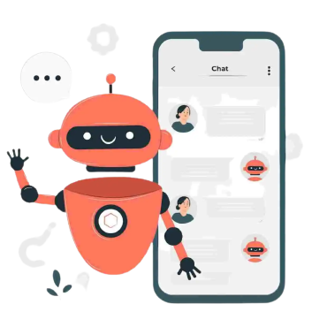

Design and Implementation of
Chat-Bot for Prospective Students:
University of Ibadan Admission Unit
Kayode Peter Temitope 208077
Akinrinola Blessing Opemipo 214857
Adeleke Timothy Toluwani 214849
Safiu Waheed 206454
GROUP 14

Slide 2
Outline
Introduction
Problem
Aims and Objective
Background
Related Works
Methodology Design
Chatbot Design and Development
Limitations and Future Improvement

Slide 3
Proposal

Slide 4
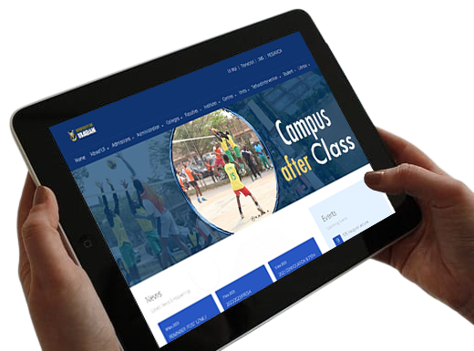
Introduction
The intersection of academia and technology presents innovative potential in higher education, with the University of Ibadan at the forefront. A silent revolution driven by Computer Science, AI, and Natural Language Processing is poised to transform student admissions, addressing complexity and inefficiencies.
Prospective students face challenges in navigating admission procedures, deadlines, and application status updates. Admissions staff dedication is hampered by potential errors and delays, causing frustrations for ambitious students.

Slide 5
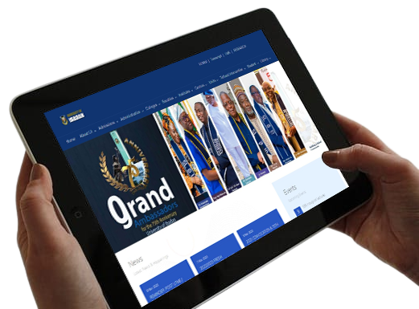
Introduction Cont'd
This research project, "Design and Implementation of a Chat-Bot for Prospective Students," rooted in Computer Science, AI, and Natural Language Processing, aims to dissolve communication barriers, offering clarity and efficiency. This chat-bot promises a more intuitive and responsive admissions experience.
Successful project completion will bring efficiency, personalized guidance, and accessibility, marking a turning point in the University's admissions process, allowing staff to focus on strategic initiatives and providing students with the confidence to embark on their academic journey.

Slide 6
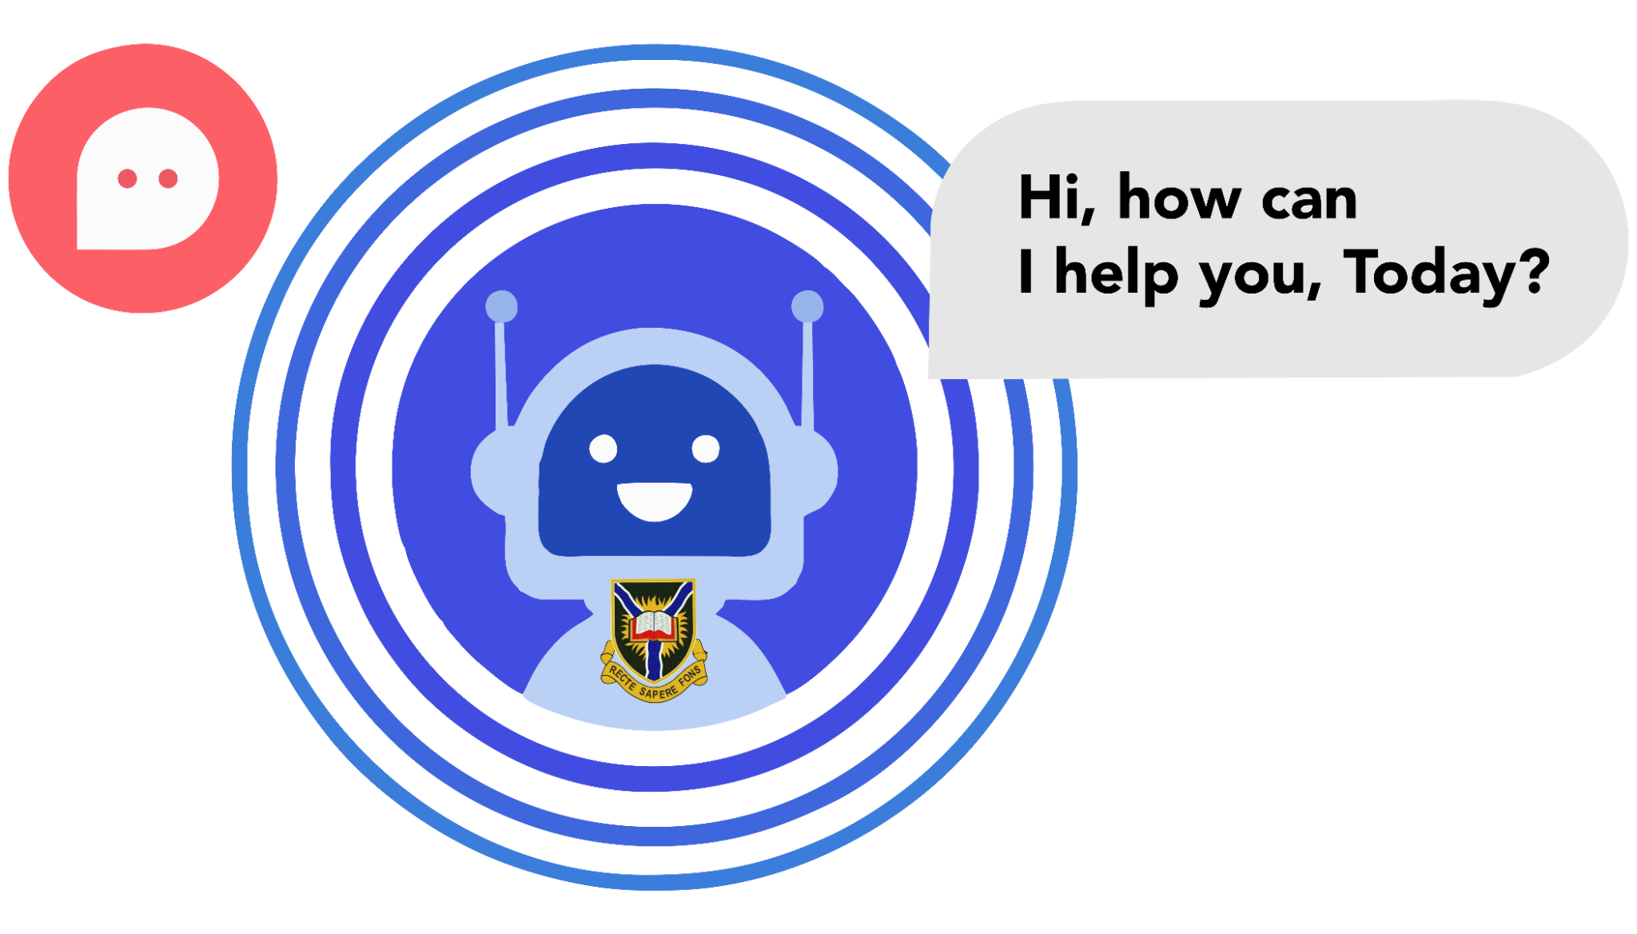
The Problem
The University of Ibadan's admissions process is complex due to the diverse applicant pool. Prospective students struggle with navigating requirements, deadlines, and course information in the manual system, leading to frustration. Admissions staff, overwhelmed by inquiries, often provide delayed and inaccurate responses.

Slide 7
Background
The University of Ibadan, part of the Academic division, plays a vital role in shaping aspiring students' academic future. The Admission Office is responsible for facilitating admissions across various academic programs, following established rules and regulations.
This process begins with disseminating information via the university's website, official bulletins, and national newspapers, encouraging applicants to upload their credentials online. After meticulous processing, successful candidates who complete Admission Post-UTME Tests have their names submitted to the Joint Admissions and Matriculation Board (JAMB) for approval.
This process highlights the complex and significant role of the admission unit within the University of Ibadan.
‹#›

Slide 8

Background Cont'd
However, increasing inquiries have created new challenges, as traditional methods are inconsistent, unavailable 24/7, and prone to misinformation.
To address these challenges, a chatbot tailored to prospective students is seen as a solution, providing prompt, accurate, and consistent information, ultimately enhancing the admission process.

Slide 9

Aim
The aim of this project is to design and implement a chatbot for prospective students that will help streamline the admission process and provide students with quick and easy access to information they need about admission requirements, application deadlines, and other relevant information.

Slide 10
Objectives
To develop a chatbot that can answer frequently asked questions about admission requirements, application deadlines, and other relevant information.
To provide prospective students with quick and easy access to information they need about admission requirements, application deadlines, and other relevant information.
To reduce the workload on staff members by automating the process of answering frequently asked questions.
To improve the efficiency of the admission process by providing prospective students with a more efficient way to get the information they need.
‹#›

Slide 11
Milestones
Requirement Gathering
Chat-Bot Development
Chat-Bot Deployment
We begin by gathering requirements from the university's admission unit through interviews, focus groups, and user surveys.
We'll develop the chatbot using a chatbot development platform with NLP and machine learning libraries to define its capabilities and knowledge base.
Post-testing approval, the chatbot is deployed on the university's website, seamlessly integrated via a CMS for efficient content management.
We design the chatbot's capabilities, interfaces, and personality to align with the university's branding, using use cases and visual representations
The chatbot undergoes comprehensive testing, including unit, integration, and user acceptance tests, ensuring a smooth experience for prospective students.
Chat-Bot Design
Chat-Bot Testing
‹#›

Slide 12
Expected Result
1
2
3
4
5
Enhanced Prospective Student Engagement
Improved Staff Efficiency
Streamlined Admission Process
Data-Driven Decision Making
Enhanced Security and Privacy
‹#›

Slide 13
Literature Review

Slide 14
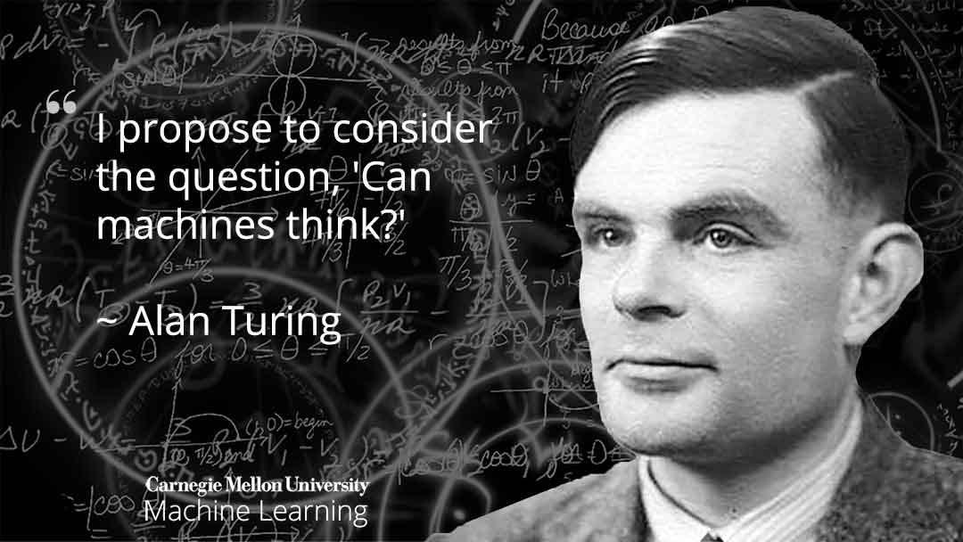

Slide 15
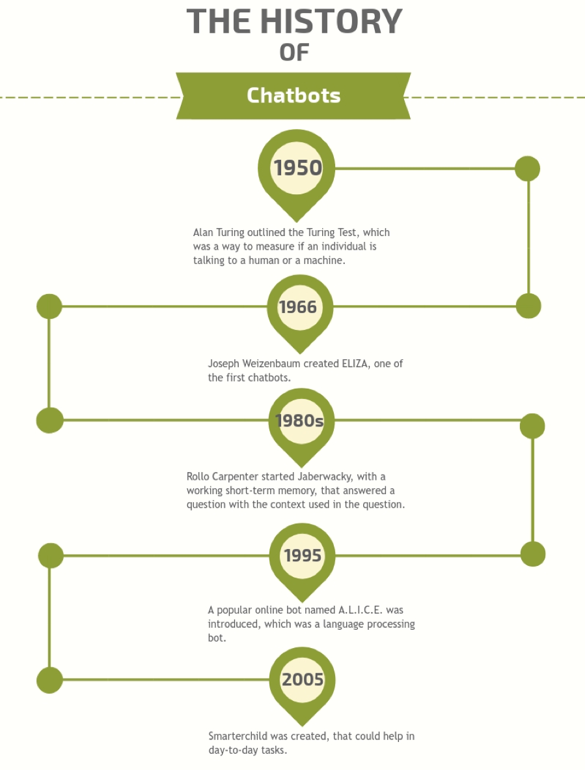
ChatBot Background
Alan Turing's 1950 proposal on the concept of chatbots, inspired by the question, "Can machines think?", laid the foundation for chatbot development.
The first implementation of a chatbot in 1966, ELIZA, relied on linguistic rules and pattern matching techniques, stimulating further research.

Slide 16
ChatBot Background
The 1980s saw the use of Artificial Intelligence Markup Language (AIML) in chatbots like A.L.I.C.E., enabling dialogue pattern knowledge expansion.
ChatScript, a successor to AIML, introduced the concept of matching textual inputs to specific topics with associated rules, emphasizing semantic analysis.
Drawback
Traditional chatbots relying on rules and pattern matching are domain-dependent and inflexible, requiring manually written rules for specific domains.

Slide 17
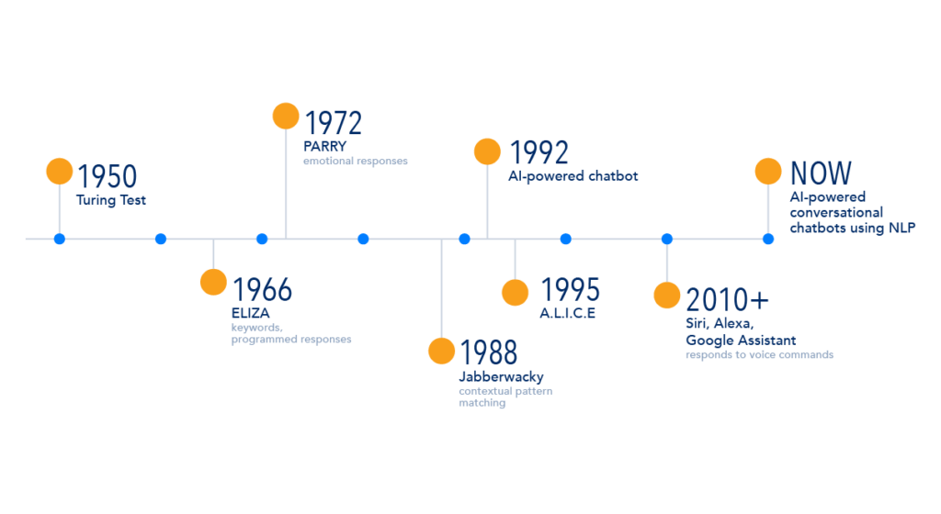

Slide 18
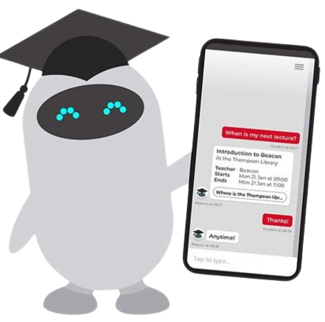
Chatbots in Higher Education
Chat-bots in higher education leverage AI and NLP to streamline administrative tasks and provide real-time, accurate information.
These chatbots reflect a broader trend in adopting AI-driven technologies for various applications in higher education.
They aim to improve the quality, efficiency, and accessibility of admission processes, ultimately elevating the prospective student's experience.

Slide 19
Dataset Used
This session summarizes the datasets that appears to be most frequently used to train deep learning chatbot models.
DATASET | CONTENT TYPE | PHRASES | TOKENS | SOURCES
OpenSubtitles | Movie subtitles. Entire database of the OpenSubtitles.org repository | 441.5 M (2018 release) | 3.2 G (2018 release) | (Lison & Tiedemann, 2016)
Cornell | Raw movie scripts. Fictional conversations extracted from raw movie scripts | 304,713 | 48,177 | (Danescu- Niculescu-Mizil & Lee, 2011)
DailyDialog | Dialogues for English learners. Raw data crawled from various websites that provide content for English learners | 103,632 (13,118 dialogues with 7.9 turns each on average) | 17,812 | (Li et al., 2017)

Slide 20
Related Works
AUTHOR | TITLE | CONTRIBUTIONS | DRAWBACK
Smith, J. | Enhancing University Admissions with AI Chat-bots. | Smith’s research demonstrates how chatbots can significantly reduce admission processing times. | Smith’s study lacks in-depth analysis of potential privacy concerns associated with chat-bot interactions
Patel (2023) | Chat-bot Assistance for Prospective Students: A Case Study. | Patel’s case study reveals the positive impact of chat-bots on prospective student inquiries and engagement | Patel’s case study has a limited scope and may not be generalizable to all university settings.

Slide 21
Related Works Cont’d
AUTHOR | TITLE | CONTRIBUTIONS | DRAWBACK
Johnson (2023) | Streamlining Admissions: The Role of Chatbots in Universities. | Johnson explores the cost effectiveness of implementing chat-bots in admissions units. | Johnson’s research does not address the challenges of integrating chat-bots with existing university systems.
Kim (2021) | Improving Student Experience through Chat-bot Solutions. | Kim focuses on the improved user experience and increased efficiency in handling student queries. | Kim’s study does not provide a comprehensive analysis of the potential resistance or skepticism from students and staff towards chat-bot adoption

Slide 22
Related Works Cont’d
AUTHOR | TITLE | CONTRIBUTIONS | DRAWBACK
Jia (2003) | The Study of the Application of a Keywords-based Chatbot System on the Teaching of Foreign Languages | The intelligence of Chatbots for conversational computer and ability to process Natural Language Processing text and input to provide relevant output | Potential for bias and discrimination in the chatbot's responses.
Okuda & Shoda (2018) | AI-based Chatbot Service for Financial Industry | Application of Chatbots in various fields, including education, e-commerce, healthcare, and entertainment, offering support and engagement for users. | Potential limitations in natural language processing (NLP), which could hinder the chatbot's ability to accurately understand and respond to diverse user queries.

Slide 23
Related Works Cont’d
AUTHOR | TITLE | CONTRIBUTIONS | DRAWBACK
Costa, P. (2018) | Conversing with personal digital assistants: On gender and artificial intelligence | Cost-effective and engagement comparison of Chatbots to the traditional Frequently Asked Questions (FAQ) pages. | While chatbots can assist multiple users simultaneously, their ability to understand conversational context is not as refined as that of humans.
Christensen, Johnsrud, Ruocco, & Ramampiaro (2018) | Context-Aware Sequence to Sequence Models for Conversational Systems | Challenges in Chatbot areas such as contextual understanding, emotional cues, and gender biases despite advancements in AI and NLP in mimicking human conversation. | It does not address issues related to emotional understanding, gender biases, and enhancing their capacity to provide more personalized responses to prospective students.

Slide 24
Related Works Cont’d
AUTHOR | TITLE | CONTRIBUTIONS | DRAWBACK
Go & Sundar (2019) | Humanizing chatbots: The effects of visual, identity, and conversational cues on humanness perceptions | Adaptability and maintainability of Chatbot alongside addressing contextual and emotional understanding and gender biases is essential for improving their performance and user experience. | Chatbots often lack contextual and emotional understanding, which can lead to misinterpretations and negative user experiences.

Slide 25
Methodology

Slide 26
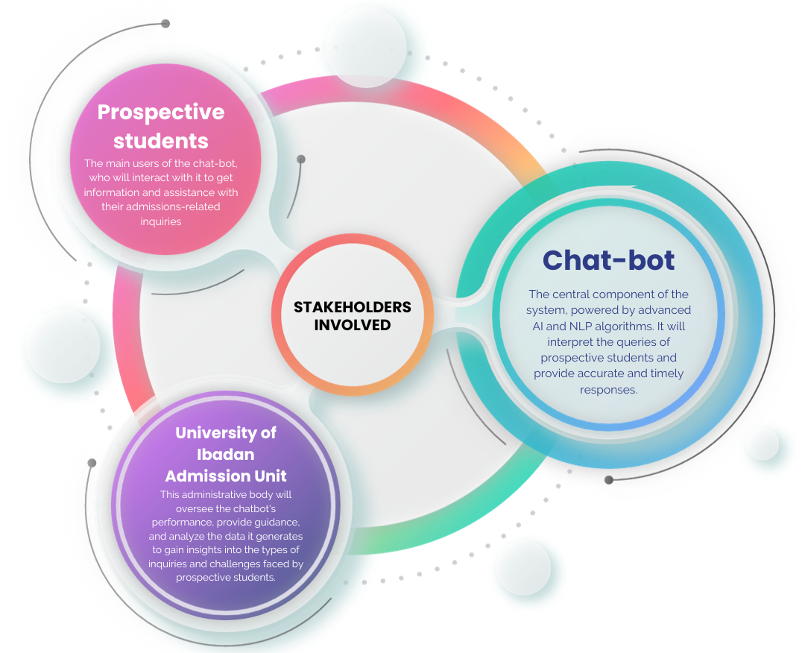
Methodology Structure
Stakeholders involved & their relationship:
Prospective students: The primary users of the chatbot are prospective students seeking information and assistance for their admission-related inquiries.
Chatbot: This is the core, which is driven by advanced AI and NLP, which will interpret and respond to prospective students’ queries.
University of Ibadan Admission Unit: This body oversees the chatbot performance, guides, and analyzes data for insights to prospective students’ inquiries and and challenges.

Slide 27
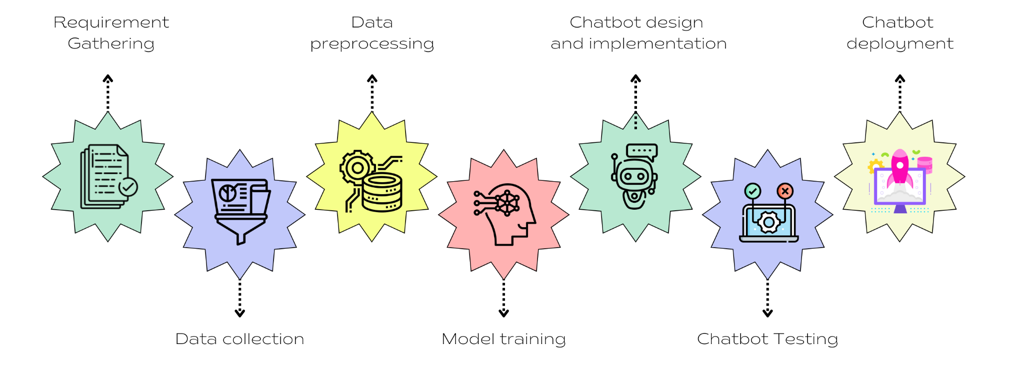
Milestones

Slide 28
System Requirements
Functional Requirement
Chatting
Searching
Logs
Feedback
Administrative System
Non Functional Requirement
User interface
Scalability
Security
Third party interaction
Portability
Maintainability
Exception handling

Slide 29

Methodology Design - Mixed
Qualitative: used to gather unique insights from prospective students and admission staff who explained and described the desired functionality, features, and potential impact of the forthcoming chatbot; and will be used to gather feedback from prospective students about their experience using the chatbot

Slide 30
Table 3.1: Data Collection and Thematic Mapping
Category | Text Segment | Code/Theme
Interview Transcripts from Prospective Students | I really wish the chatbot could provide information about the admission requirements and criteria, like the specific grades needed for each program. | Admission Requirements Information
 | I find it frustrating when I have to search through the website to find basic admission details. The chatbot should be easy to navigate and user-friendly. | User-Friendly Interface
 | I appreciate it when I get immediate responses to my questions. It's frustrating to wait for hours or days to get a reply. | Immediate Responses

Slide 31
Table 3.1: Data Collection and Thematic Mapping (Cont’d)
Category | Text Segment | Code/Theme
Open-Ended Survey Responses from Admission unit Staff | We often receive inquiries from students about the admission deadlines. It would be helpful if the chatbot could automatically provide this information. | Automated Admission Deadlines
 | Students often ask us the same questions repeatedly, especially during the admission season. If the chatbot could handle these common queries, it would save us a lot of time. | Handling Common Queries

Slide 32
Methodology Design
Quantitative: used to gather quantitative surveys and analytics to access the performance and user satisfaction of the chatbot. This includes:
Accuracy
Precision and Recall
F1 - score
Response time

Slide 33
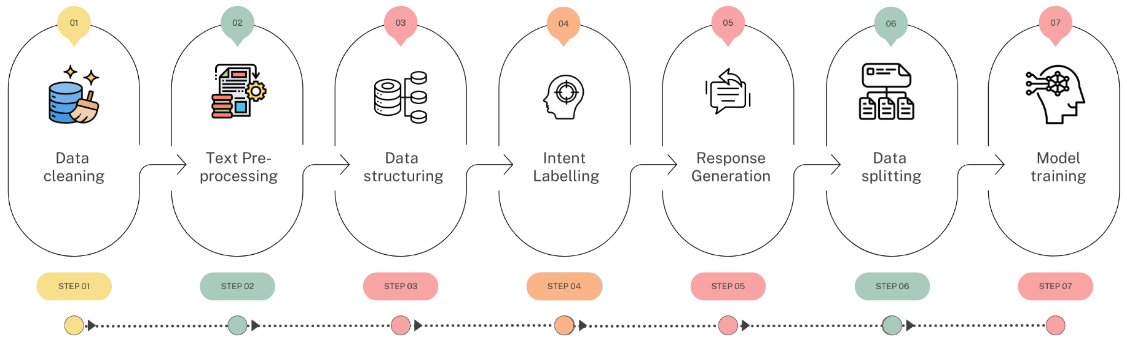
Data Preprocessing

Slide 34
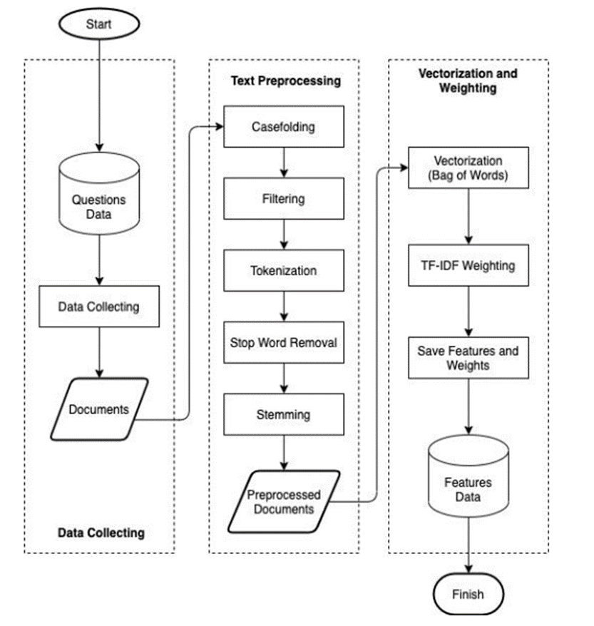
Model Training

Slide 35
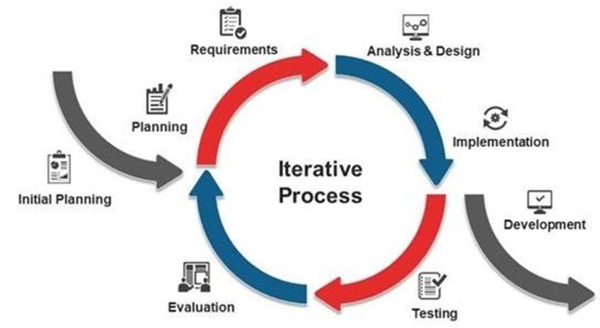
ChatBot Development

Slide 36
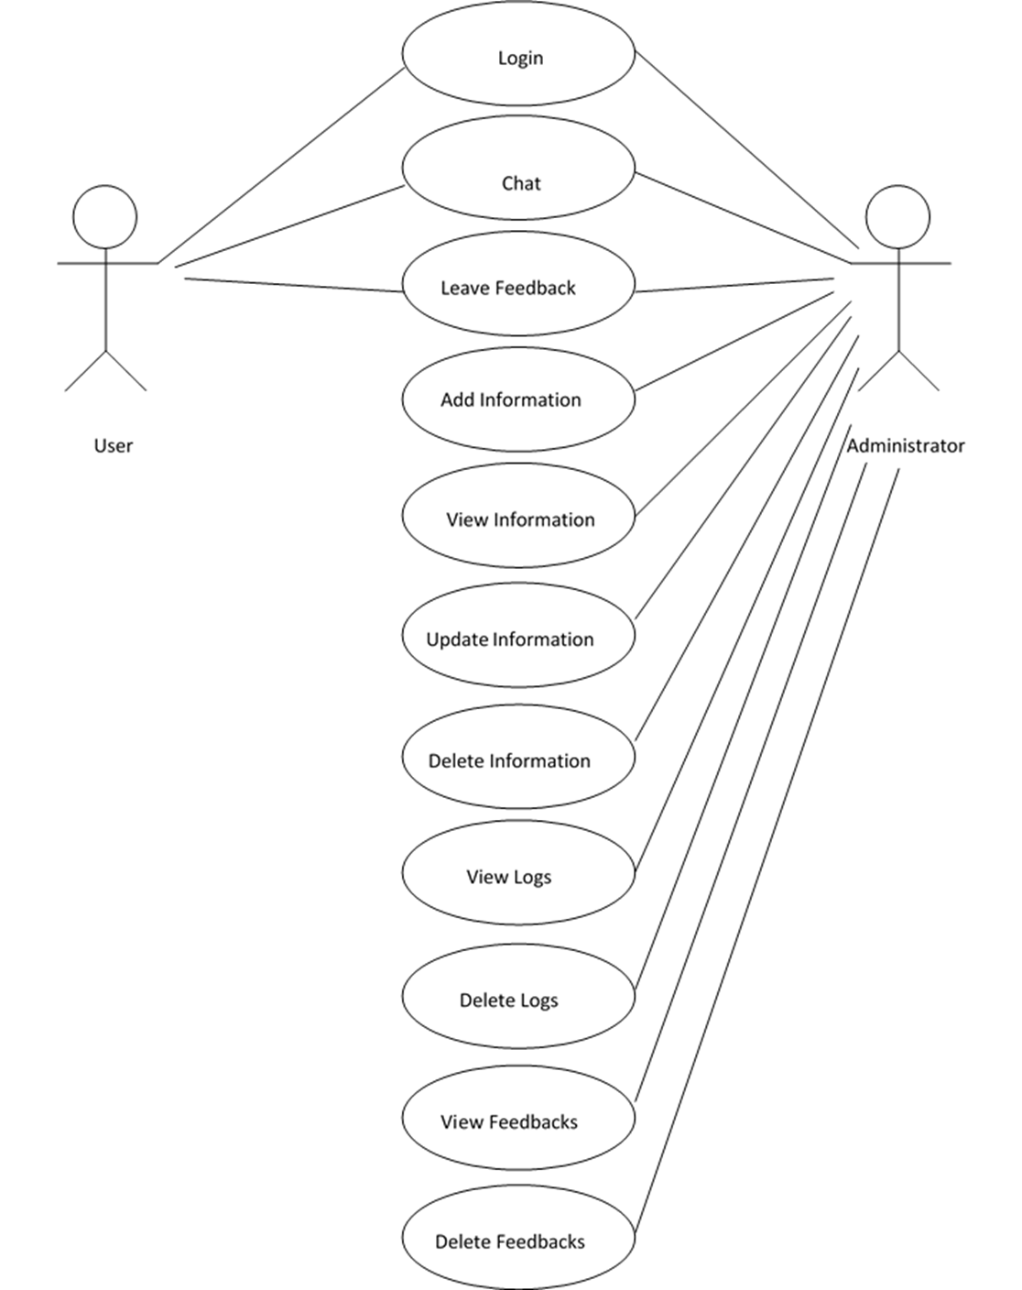
Use case Model

Slide 37
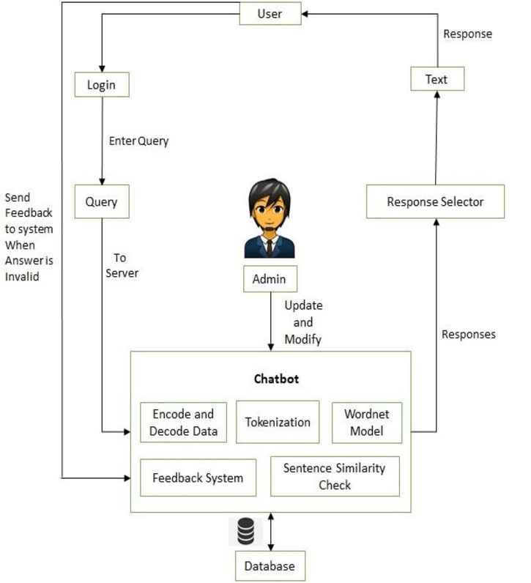
User Flow

Slide 38
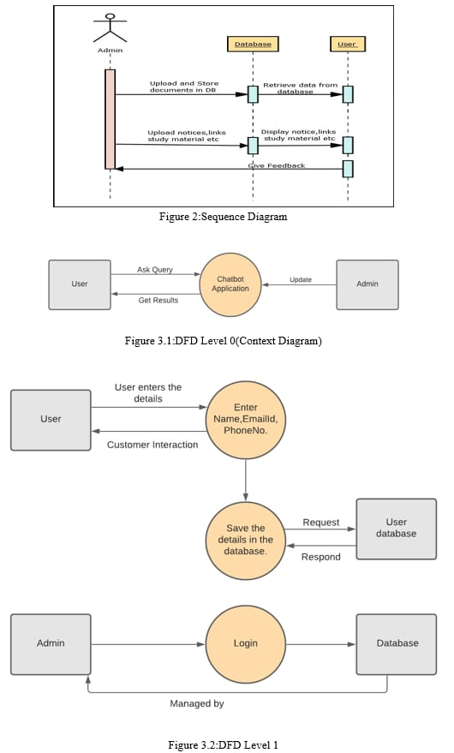
Sequence Diagram

Slide 39
Data flow Diagram
Level 0

Slide 40
Data flow Diagram
Level 1

Slide 41
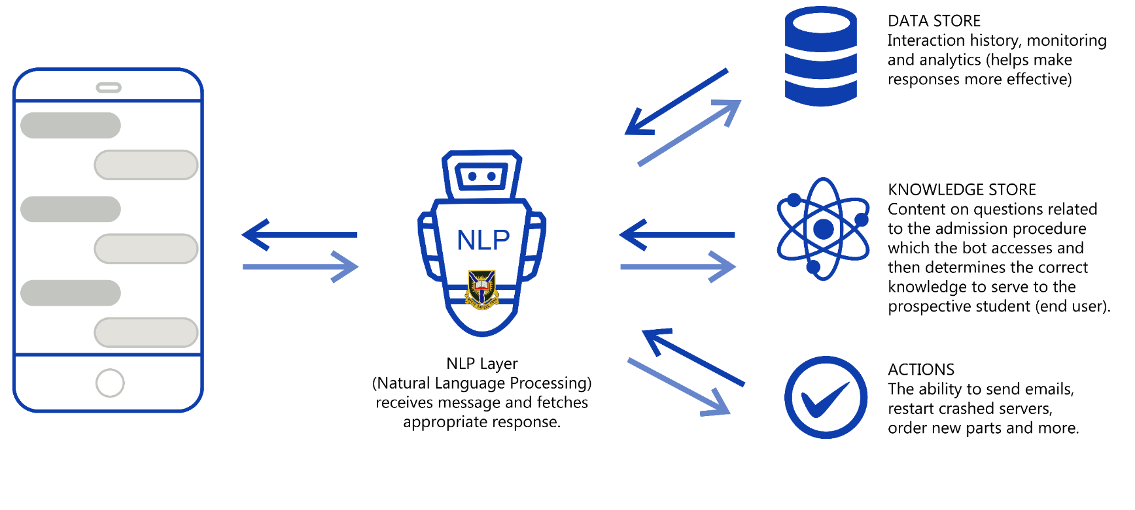
ChatBot Framework

Slide 42
ChatBot Interaction Design
Design of the dialogue script that outlines how the chatbot will interact with users, the questions it will ask, and the responses it will provide based on user inputs.
04
01
03
Integration and Platform Design
Interface Design
Knowledge Base Design
Conversational Design
02
Design of the chatbot's conversation flow, the layout of the chat window, and the visual elements, such as buttons and menus, for a user-friendly experience.
This include planning for integration with university databases and selecting the platforms (e.g., website, mobile app, messaging apps)
Design of the information and data it will draw upon to answer user queries

Slide 43
Testing Strategy
Continuous Testing
User Involvement
Automation and Regression
Start testing from the project's inception, testing alongside development efforts, and adapting as the project progresses.
Actively engage users, including prospective students, in the testing process to align the chatbot with their expectations and requirements.
Implement automated testing to expedite routine checks and conduct frequent regression testing to ensure new changes don't introduce defects.
Organize dedicated test sprints alongside development sprints, focusing on specific chatbot aspects like functionality, user interface, and conversational flow.
Embrace CI/CD practices to automate build, testing, and deployment, ensuring the chatbot remains in a deployable state and that new features are thoroughly tested before release.
Test Sprints
CI/CD Integration

Slide 44
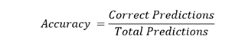
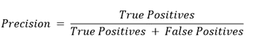
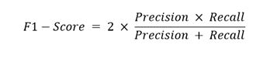
Performance Evaluation
Accuracy
Precision and Recall
F1 - Score
Measures the chatbot's ability to correctly understand user intents and provide accurate responses. This is particularly important for tasks like intent classification and entity recognition.
This metric is useful for evaluating the performance of the chatbot in tasks like entity recognition and question answering, where there may be a trade-off between precision and recall.
It is the harmonic mean of precision and recall, therefore, it will measure the balance of the chatbot's performance.

Slide 45
Deployment Process
Platform Selection
Integrating with University Systems
Quality Assurance
Determine the platforms on which the chatbot will be made available. This may include the university's website, mobile applications, and popular messaging platforms like WhatsApp, Facebook Messenger, or a custom chat interface.
Ensure that the chatbot is integrated with relevant university databases and systems. This allows the chatbot to retrieve real-time data, such as admission status or program availability, to provide accurate and up-to-date information
Before deploying the chatbot, conduct extensive testing to ensure it functions correctly, provides accurate information, and offers a smooth user experience. Address any issues or bugs that arise during testing.
Provide a channel for users to get support if they encounter difficulties when using the chatbot. This may involve setting up a dedicated support team or a chatbot "escalation" feature to connect users with human agents when needed.
Establish a feedback loop to continuously gather insights and suggestions from users. Use this feedback to refine and enhance the chatbot over time.
User Support
Feedback Loop

Slide 46
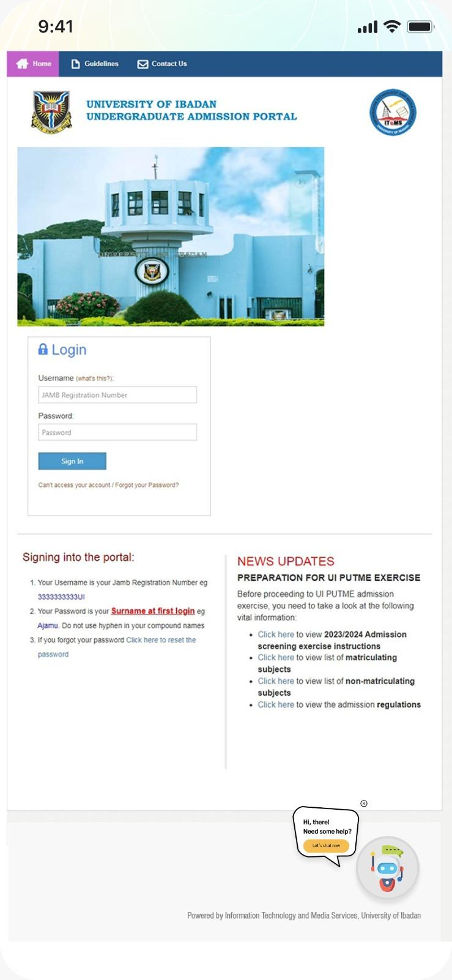
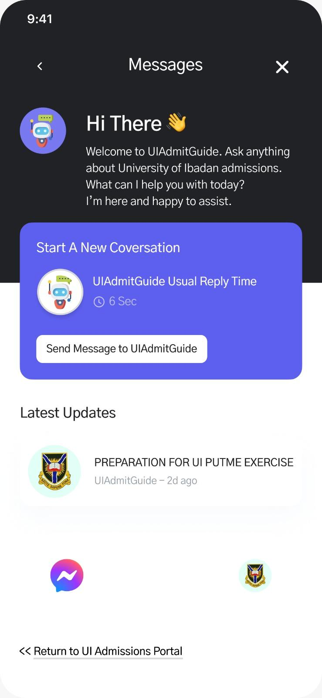
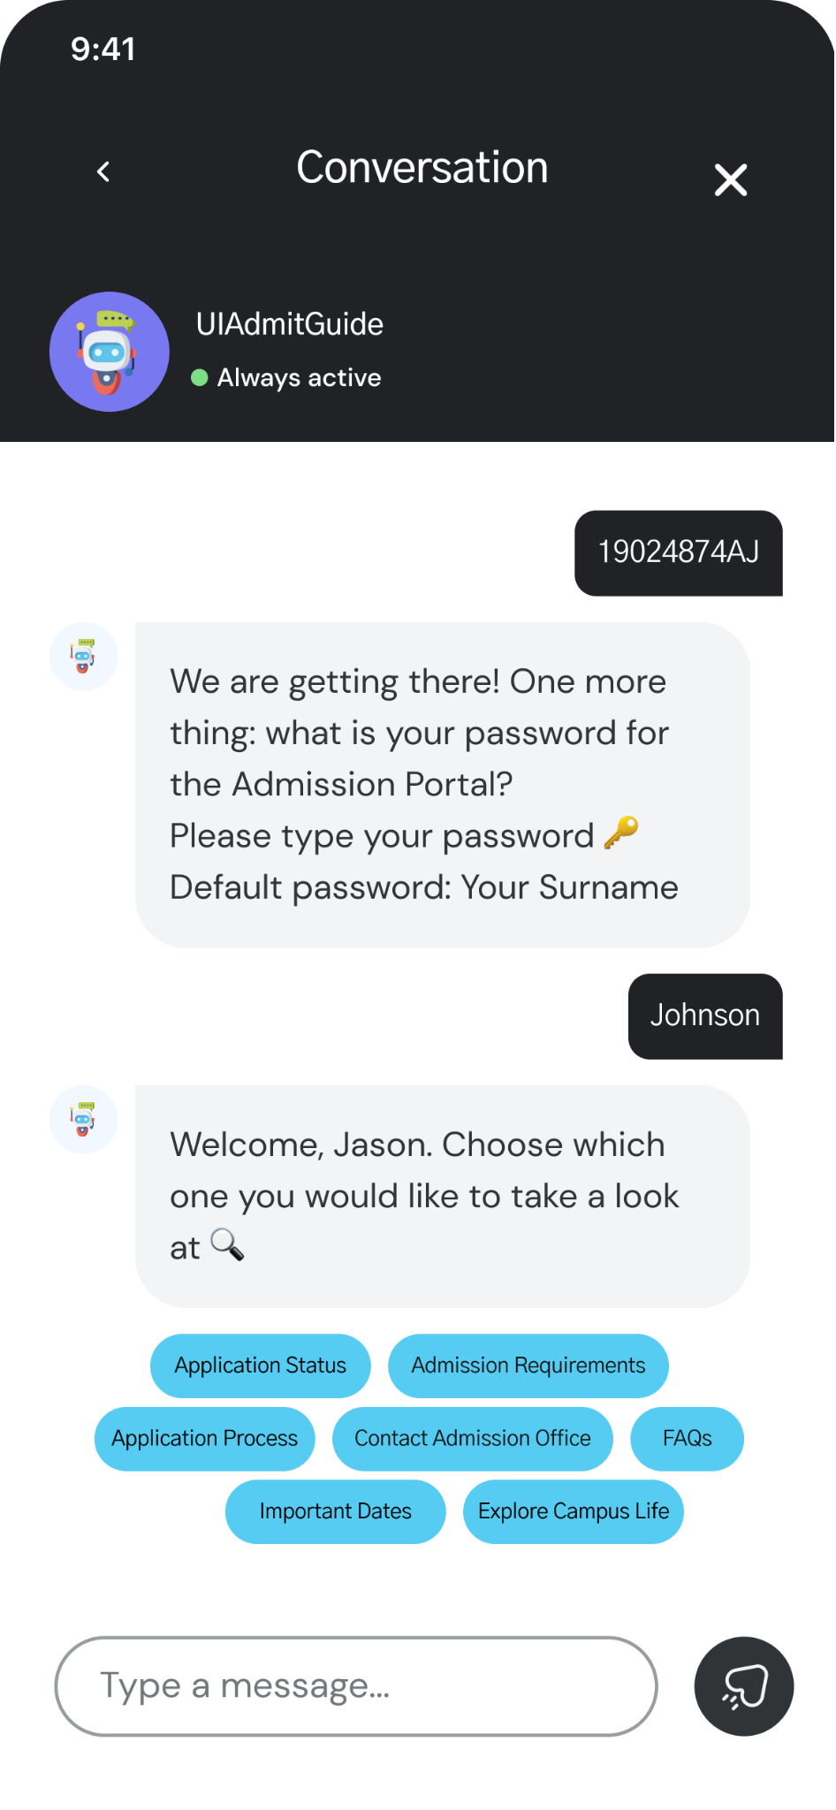

Slide 47
Limitations
1
2
3
4
5
Sample Representativeness
Self Reporting Bias
Subjectivity in the thematic analysis
Temporal constraint
Language and cultural nuance

Slide 48
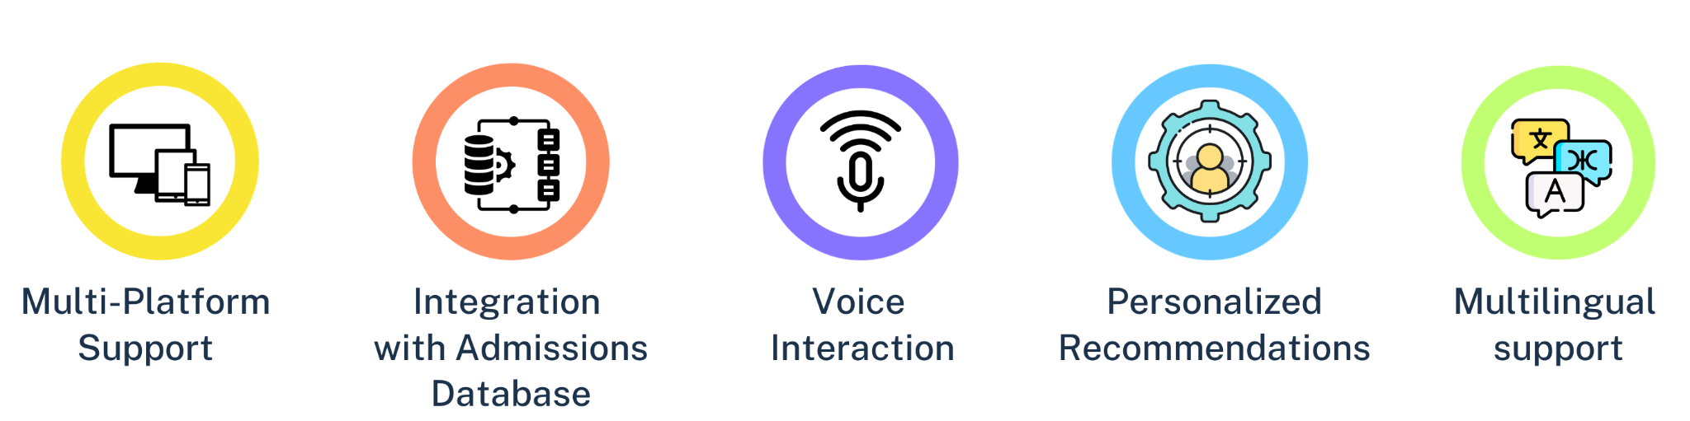
Future Improvements

